Slide 1
Epilepsy Pharmacotherapy:
Epidemiology & Clinical Presentation
Barry E. Gidal, PharmD, FAES

Slide 2
IS THERE OVERLAPPING PHARMACOLOGY IN PATIENTS WITH REFRACTORY NEUROPSYCHIATRIC DISORDERS?
Bipolar disorder
Epilepsy
Schizophrenia
Depression
Anxiety
ADHD
Brodie M. 2016
? EPILEPTIC BRAIN?

Slide 3

Definitions
Seizure: the clinical manifestation of an abnormal, excessive excitation and synchronization of a population of cortical neurons
Epilepsy: recurrent seizures (two or more) which are not provoked by systemic or acute neurologic insults
Notes:
A seizure is the manifestation of an abnormal, hypersynchronous discharge of a population of cortical neurons. This discharge may produce subjective symptoms or objective signs, in which case it is a clinical seizure, or it may be apparent only on an electroencephalogram (EEG), in which case it is an electrographic (or subclinical) seizure.

Slide 4
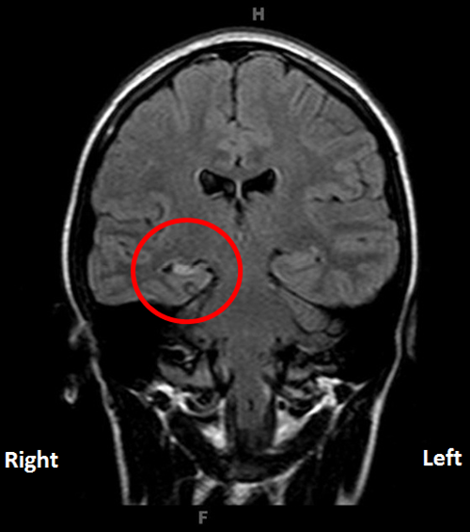

Slide 5
Epidemiology of Seizure / Epilepsy
~ 10% population – single seizure during lifetime
~ 4-5% population – epilepsy – two or more unprovoked seizures in lifetime
~1-2% population – epilepsy now
  30% intractable
  30% occasional seizures
  40% controlled on medications

Slide 6
Incidence and Prevalence of Epilepsy in the United States
Community incidence¹:
Rochester, Minn (1935–1984)
Male
Female
Total
Epilepsy affects more than 3 million people²
200,000 new cases of epilepsy diagnosed annually²
Incidence per 100,000 person-y
ears
Age (years)
1. Hauser WA et al. Epilepsia. 1993;34:453–468. Adapted with permission of Epilepsia.
2. Epilepsy Foundation. Epilepsy Fact Sheet. http://www.epilepsyfoundation.org/about/factsfigures.cfm. Accessed June 2, 2009.
Notes:
Within the United States, epilepsy affects more than 3 million people.¹ And each year, approximately 200,000 people in the United States are diagnosed with epilepsy.¹ This incidence is not uniformly distributed with age; new cases of epilepsy are diagnosed at notably high rates in pediatric patients younger than 2 years of age and in adults older than 55 years of age.² This pattern has been confirmed by a meta-analysis of 32 studies conducted in several industrialized and developing nations, which showed there is a high incidence of epilepsy in childhood as well as an increased incidence in the elderly.³ Approximately 25% of new cases of epilepsy occur in women and men older than 60 years of age.⁴
In fact, in Western countries epilepsy may increasingly appear to be a disease of older adults.⁵ In Rochester, the proportion of incident epilepsy cases in those 65 years of age or older approximately doubled from 14% to 29% over the period from 1935 to 1984. With the aging of the US population, this trend is expected to continue.
References:
1. Epilepsy Foundation. Epilepsy Fact Sheet. http://www.epilepsyfoundation.org/about/factsfigures.cfm. Accessed February 11, 2009.
2. Hauser WA, Annegers JF, Kurland LT. Incidence of epilepsy and unprovoked seizures in Rochester, Minnesota: 1935–1984. Epilepsia. 1993;34:453–468.
3. Kotsopoulos IA, van Merode T, Kessels FG, de Krom MC, Knottnerus JA. Systematic review and meta-analysis of incidence studies of epilepsy and unprovoked seizures. Epilepsia. 2002;43:1402–1409.
4. Stephen LJ, Brodie MJ. Epilepsy in elderly people. Lancet. 2000;355:1441–1446.
5. Annegers JF. The epidemiology of epilepsy. In: Wyllie E, ed. The Treatment of Epilepsy: Principles and Practice. 3rd ed. Philadelphia, Pa: Lippincott Williams & Wilkins; 2001:131–138.

Slide 7
Risk for Epilepsy:
Prenatal and Perinatal Factors
Baseline
Obstetric problems*
Toxemia*
Delivery problems*
Maternal hemorrhage
Perinatal problems
Prematurity
Low birth weight
Neonatal seizures
Small for gestational age
Neonatal hypoxia
Mental retardation (MR)
Cerebral palsy (CP)
MR and CP
0.1
1
10
100
Rate Ratio (logarithmic scale)
*Not statistically significant.
Adapted with permission from Hessdorffer DC, et al. Epilepsy: A Comprehensive Textbook. Philadelphia, Pa: Lippincott-Raven Publishers: 1997:59-67.

Slide 8
Adult Risk Factors for Epilepsy
Military head injury (HI)
580
Civilian HI (severe)
29
Civilian HI (moderate)
4
Civilian HI (mild)*
1.5
Stroke
20
Embolic risk factors
2.3
LVH without Rx
7.3
LVH with Rx**
0.7
Hypertension*
1.3
Encephalitis
16
Bacterial meningitis
4
Aseptic meningitis
2
Alzheimer’s disease
10
Multiple sclerosis
4
Alcohol
3
Heroin
3
Marijuana**
0.4
Depression*
3.7
Neuroleptic drugs*
1.3
Tricyclic antidepressants*
1.5
Electroconvulsive shock therapy*
1.5
No risk
1
0.1
1
10
100
1000
*Not significant; **Protective; LVH – Left ventricular hypertrophy.
Adapted with permission from Hessdorffer DC, et al. Epilepsy: A Comprehensive Textbook. Philadelphia, Pa: Lippincott-Raven Publishers; 1997:59-67.

Slide 9
Epilepsy and Other Chronic Convulsive Diseases
‘ Every fit, slight or severe, is in some degree
the effect of those which precede it,
the cause of those that follow it.’
William Gowers, M.D.,1881

Slide 10
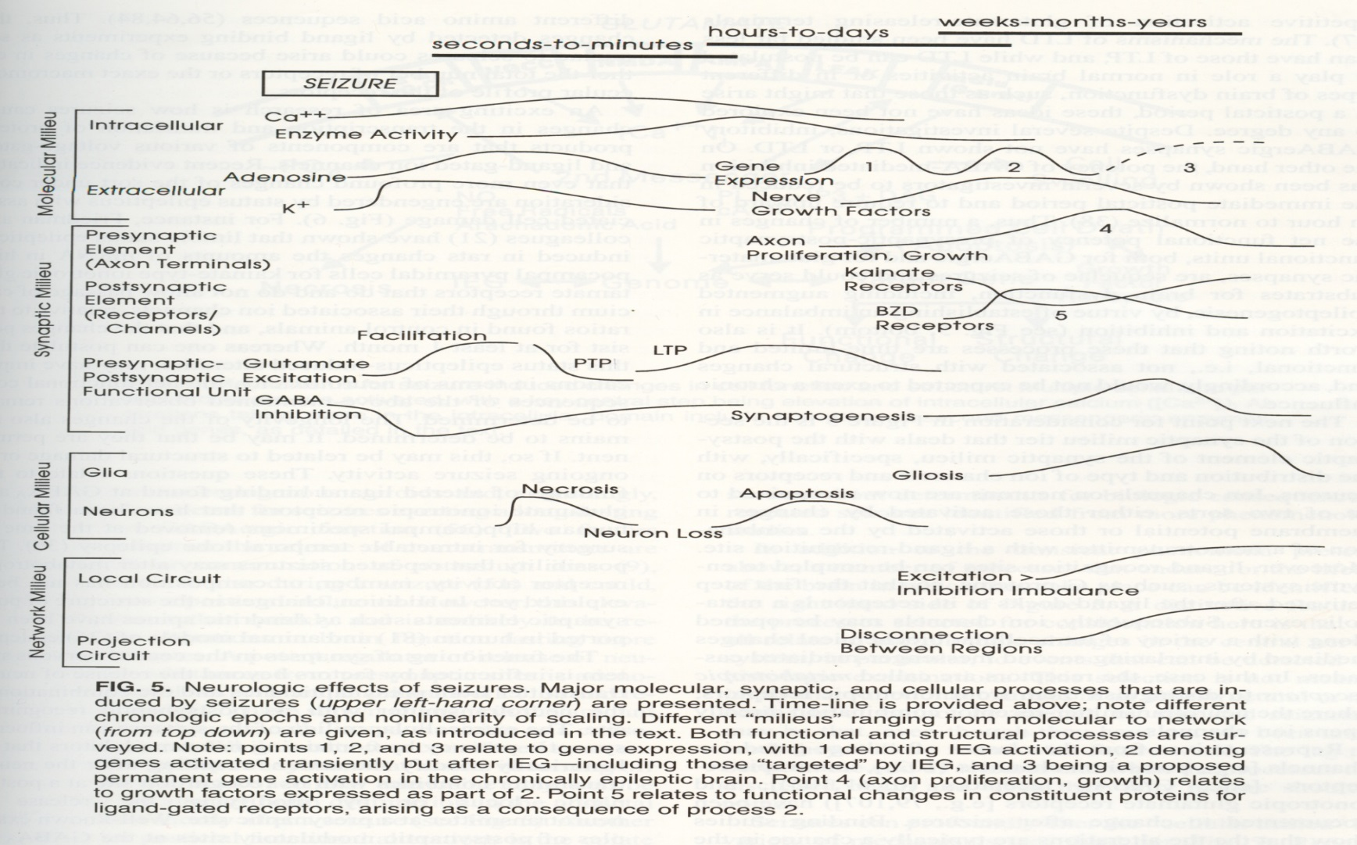
Molecular, Synaptic, and Cellular Effects of Seizures
Lotham E, 1997
Notes:
10

Slide 11
ILAE Classification of Seizures
Seizures
Partial
Generalized
Simple Partial
Absence
Complex Partial
Myoclonic
Secondarily
Generalized
Atonic
Tonic
Tonic-Clonic
ILAE – International League Against Epilepsy
American Epilepsy Society 2010
Notes:
Seizures can be classified based on their clinical and electrographic features. The diagnosis of a patient’s epilepsy syndrome is based on their clinical history and their seizure type(s).

Slide 12
Complex Partial Seizures
Seizures
⬧ Impaired consciousness
⬧ Clinical manifestations vary with site of origin and degree of spread
  Presence and nature of aura
  Automatisms
  Other motor activity
⬧ Duration typically < 2 minutes
Partial
Generalized
Complex
Partial
Notes:
Complex partial seizures are seizures which are associated with impairment of consciousness. A common misunderstanding is that this requires seizure spread to both sides of the brain. The majority of complex partial seizures originate in the temporal lobe and can affect consciousness while still remaining focal. During complex partial seizures the patient tends to stare off. This is accompanied by impaired responsiveness, cognitive function, and recall, although some degree of responsiveness may be preserved (e.g., orienting toward a stimulus). Automatic movements (automatisms) are common and involve the mouth (e.g., lip smacking, chewing, swallowing), upper extremities (e.g., fumbling, picking), vocalization/verbalization (e.g., grunts, repeating a phrase), or complex acts (e.g., shuffling cards). More dramatic automatisms occasionally occur (e.g., screaming, running, disrobing, pelvic thrusting). Complex partial seizures usually last from 15 seconds to 3 minutes. After the seizure, postictal confusion is common, usually lasting less than 15 minutes, although other symptoms, such as fatigue, may persist for hours.

Slide 13
Secondarily Generalized Seizures
⬧ Begins focally, with or without focal neurological symptoms
⬧ Variable symmetry, intensity, and duration of tonic (stiffening) and clonic (jerking) phases
⬧ Typical duration 1-3 minutes
⬧ Postictal confusion, somnolence, with or without transient focal deficit
Seizures
Partial
Generalized
Secondarily
Generalized
American Epilepsy Society 2010
Notes:
Partial seizures can progress to generalized seizures with tonic-clonic activity. Once a partial seizure secondarily generalizes it is generally impossible to differentiate from a primarily generalized seizure. The history, electroencephalogram (EEG), neurologic exam (especially postictally), and neuroimaging tests (CT or MRI) often help distinguish these seizure types. In secondarily generalized seizures, patients may recall an aura prior to the convulsive activity or witnesses may observe a simple partial or complex partial seizure prior to generalization. In addition, following a secondarily generalized seizure, the patient may have focal weakness (Todd’s paralysis) on the side contralateral to seizure onset.

Slide 14
ILAE Classification of Seizures
Seizures
Partial
Generalized
Absence
Myoclonic
Atonic
Tonic
Tonic-Clonic
American Epilepsy Society 2010
Notes:
Generalized seizures affect both cerebral hemispheres from the beginning of the seizure. They produce loss of consciousness, either briefly or for a longer period of time, and are sub-categorized into several major types: absence, myoclonic, atonic, tonic, and tonic-clonic.

Slide 15
Typical Absence Seizures
⬧ Brief staring spells (“petit mal”) with impairment of awareness
  3-20 seconds
  Sudden onset and sudden resolution
  Often provoked by hyperventilation
  Onset typically between 4 and 14 years of age
  Often resolve by 18 years of age
⬧ Normal development and intelligence
⬧ EEG: Generalized 3 Hz spike-wave discharges
Seizures
Partial
Generalized
Absence
American Epilepsy Society 2010
Notes:
Absence (petit mal) seizures are brief episodes, usually lasting 3-20 seconds, of staring with impairment of awareness and responsiveness. There is no warning before the seizure, and immediately afterward the person is alert and attentive. This lack of a postictal period is a key feature that allows one to distinguish between absence and partial complex seizures. If duration is >10 seconds, there are often accompanying motor phenomena (e.g., eye blinks, brief automatic mouth or hand movements, changes in muscle tone). These spells usually begin between ages 4 and 14 years, and usually resolve by age 18. Absence seizures are often provoked by hyperventilation, an effective means of reproducing seizures in the office or during the EEG. The EEG signature of absence epilepsy is the generalized 3 Hz spike-wave discharge. Children with typical absence seizures usually have normal development and intelligence.

Slide 21
Myoclonic Seizures
Epileptic Myoclonus
⬧ Brief, shock-like jerk of a muscle or group of muscles
⬧ Differentiate from benign, nonepileptic myoclonus (e.g., while falling asleep)
⬧ EEG: Generalized 4-6 Hz polyspike-wave discharges
Seizures
Partial
Generalized
Myoclonic
American Epilepsy Society 2010
Notes:
Myoclonic seizures involve a brief, shock-like jerk of a muscle or group of muscles. Benign myoclonus occurs in healthy people (e.g., while falling asleep). This is not a myoclonic seizure. Pathologic myoclonus can result from epileptic and nonepileptic causes. Epileptic myoclonus usually causes bilateral, synchronous jerks most often affecting the neck, shoulders, upper arms, body, and upper legs. Consciousness does not usually seem to be impaired, although this is difficult to verify given the brief duration of <1 second; if several occur in rhythmic succession, this may be termed a clonic seizure, and may be associated with altered awareness. EEG during a myoclonic seizure typically shows a polyspike-and-slow-wave discharge. Myoclonic seizures occur in a variety of epilepsy syndromes. Rarely they may be seen as part of a progressive, degenerative condition (i.e., progressive myoclonic epilepsy).

Slide 22
Tonic and Atonic Seizures
Tonic seizures
Symmetric, tonic muscle contraction of
extremities with tonic flexion of waist and neck
Duration - 2-20 seconds.
EEG – Sudden attenuation with generalized, low-voltage fast activity (most common) or generalized polyspike-wave.
Atonic seizures
Sudden loss of postural tone
  When severe often results in falls
  When milder produces head nods or jaw drops.
Consciousness usually impaired
Duration - usually seconds, rarely more than 1 minute
EEG – sudden diffuse attenuation or generalized polyspike-wave
Seizures
Partial
Generalized
Tonic
Atonic
Notes:
Atonic and tonic seizures, like atypical absence, are most common in people with other neurologic abnormalities in addition to epilepsy.
In contrast to partial motor seizures, tonic seizures are generalized, involving bilateral musculature in a symmetric or nearly symmetric manner. Tonic seizures are characterized by flexion at the waist and neck, abduction and flexion or extension of the upper extremities, and flexion or extension of the lower extremities. They typically occur during sleep and last 2-20 seconds. EEG usually shows generalized, low-voltage, fast polyspikes.
Atonic seizures consist of a sudden loss of postural tone, often resulting in falls, or, when milder, head nods or jaw drops. Consciousness is usually impaired and significant injury may occur. Duration is usually several seconds, rarely more than 1 minute. EEG often shows an electrodecremental response.
Epileptic drop attacks may occur not just with atonic seizures, but also with myoclonic or tonic seizures if the legs are involved.

Slide 23
Generalized Tonic-Clonic Seizures
Associated with loss of consciousness and post-ictal confusion/lethargy
Duration 30-120 seconds
Tonic phase
  Stiffening and fall
  Often associated with ictal cry
Clonic Phase
  Rhythmic extremity jerking
EEG – generalized polyspikes
Seizures
Partial
Generalized
Tonic-
Clonic
American Epilepsy Society 2010
Notes:
Primary generalized tonic-clonic (also called grand mal or convulsive seizures) seizures cause loss of consciousness associated with an initial tonic phase of stiffening, a fall, and often a cry evoked by air forced through contracted vocal cords. Legs are usually extended, and arms may be extended, flexed, or each in succession. The subsequent clonic phase consists of jerking of the extremities which gradually slows before stopping. Tonic-clonic seizures usually last 30-120 seconds. There may be drooling or foaming resulting from lack of swallowing and excessive salivation; biting of the tongue, cheek, or lip, causing bleeding; and bladder or bowel incontinence. Postictal lethargy and confusion often last minutes to hours, and may be followed by transient agitation. The EEG shows generalized polyspikes, but these are usually obscured by muscle artifact. Postictally, there is background suppression and then diffuse slowing.

Slide 25
Seizure Precipitants
⬧ Metabolic and Electrolyte Imbalance
⬧ Stimulant/other proconvulsant intoxication
⬧ Sedative or ethanol withdrawal
⬧ Sleep deprivation
⬧ Antiepileptic medication reduction or inadequate
AED treatment
⬧ Hormonal variations
⬧ Stress
⬧ Fever or systemic infection
⬧ Concussion and/or closed head injury
American Epilepsy Society 2010
Notes:
One or more precipitating factors can contribute to the patient’s seizure. The discovery of a precipitant does not obviate the need to search for intracranial pathology or a genetic predisposition toward seizures, but may lead to a non-epilepsy diagnosis (e.g., alcohol withdrawal seizure), and is very useful in counseling the patient. Common precipitants include metabolic and electrolyte imbalance (such as low blood glucose, low sodium, low calcium or low magnesium), antiepileptic medication reduction or inadequate AED treatment, hormonal variations, stress, infection, severe sleep deprivation, withdrawal from alcohol or other sedative agents, and administration of drugs with proconvulsant properties, such as central nervous system stimulants including cocaine, anticholinergics (including over-the-counter antihistamines), almost all dopamine blocking agents, newer antipsychotics (particularly clozapine), antidepressants (especially buproprion), immune suppressants such as cyclosporine, and antibiotics such as quinolones or imipenem-cilastatin.

Slide 26
Seizure Precipitants (cont.)
Metabolic and Electrolyte Imbalance
Low blood glucose
  (or high glucose, esp. w/ hyperosmolar state)
Low sodium
Low calcium
Low magnesium
American Epilepsy Society 2010

Slide 27
Seizure Precipitants (cont.)
Medications that can lower seizure threshold
Antidepressants:
  Bupropion ?
  Tricyclics ?
Neuroleptics
  Phenothiazines
  Clozapine
Theophylline
Isoniazid
Penicillins
Cyclosporin
Meperidine
Cocaine
Ephedrine
Some herbals

